Slide 1
Dimensioning Modeling Demystified
Star Schema vs. Snowflake Schema
2025

Slide 2
What covered in this slides?
Introduction to Data Warehousing
Dimensional Modeling
Star Schema
Snowflake Schema
Comparison between Star Schema and Snowflake Schema
What to use when?

Slide 3
Data Warehousing

Slide 4
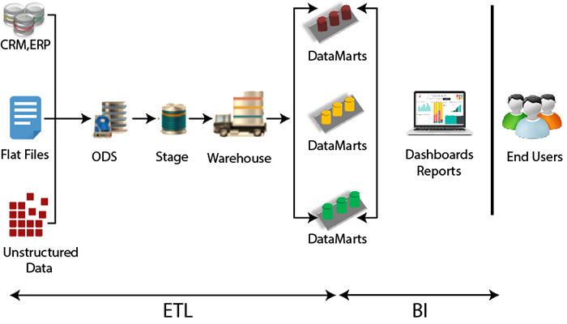
Brief on Data Warehousing
Collecting, storing, managing large volume of data from multiple sources.
Components: Data sources, ETL process, Data Storage, Metadata, Access tools.
Benefits: Improved decision making, Enhance Data Quality, Performance, Historical Analysis.
Data warehouses are optimized for read-heavy operations, complex queries and data analysis.
OLAP rather than OLTP
Designed to scale with growing data volumes.
Notes:
Can we do OLTP in datawarehousing?
Yes, we can do. But it is like feeding elephant with spoon. Don’t try it guys
Data lake- storing datawarehouse in cloud to support for big data
Data virtualization- virtually collecting the data from multiple source so no extra storage is required. It has less performance capability and scalability. Infact it is most difficult to maintain.

Slide 5
Data Dimensional Modeling

Slide 6
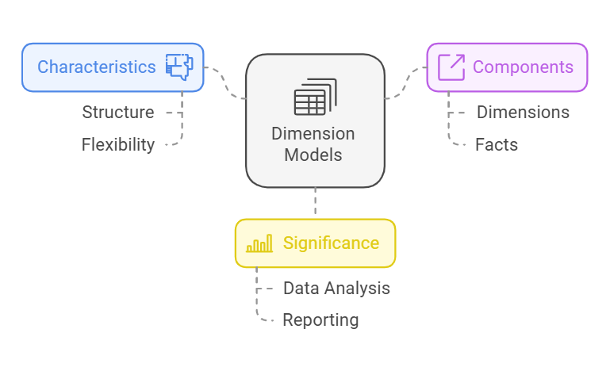
Understanding Dimension Models
Dimension models are a fundamental concept in data warehousing and business intelligence, providing a structured way to organize and analyze data. This document explores the characteristics, components, and significance of dimension models in the context of data analysis and reporting.
It organizes data into a structure that makes it easy to retrieve and analyze for decision-making. It primarily involves facts and dimensions, forming a star-like or snowflake-like schema.
Notes:
A Data Model in a Database Management System (DBMS) is a conceptual framework that defines how data is organized, stored, and manipulated. It provides a systematic way to represent and manage data, relationships, and constraints, making it easier to understand and use the database.

Slide 7
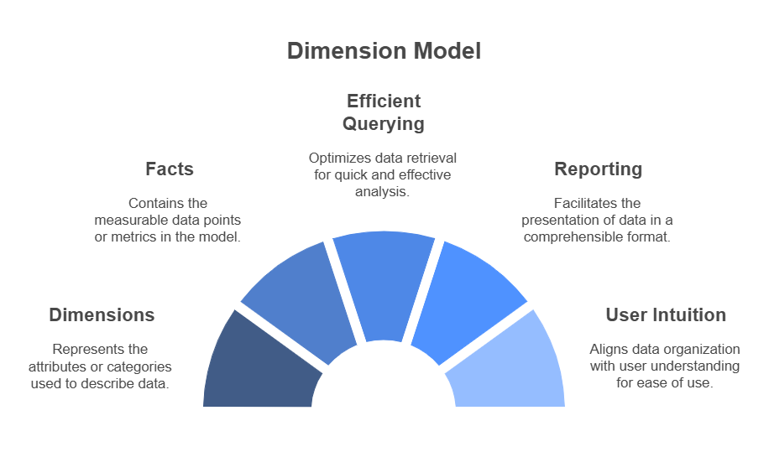
What is a Dimension Model?
A dimension model is a design framework used in data warehousing that focuses on the organization of data into dimensions and facts. It allows for efficient querying and reporting by structuring data in a way that is intuitive for users. The primary goal of a dimension model is to enable users to analyze data from various perspectives, making it easier to derive insights and make informed decisions.
Notes:
Efficient querying
Reporting by structuring data
Basically making it easy for data analysts.

Slide 8
What is Dimensional Model
Product Dimension
Product Dimension Identifier(PK)
Product Category
Product Sub-Category
Product Name
Product Feature Description
Date Time Stamp
Organization Dimension
Organization Dimension identifier(PK)
Corporate Office Name
Region Name
Branch Name
Employee Name
Date Time Stamp
Sale Fact
Time Dimension identifier(PK)
Location Dimension identifier(PK)
Product Dimension identifier(PK)
Organization Dimension identifier(PK)
Sale Dollar
Date Time Stamp
A dimensional model is a database structure that is optimized for online queries and data warehousing tools.
It is comprised of “fact” and “dimension” tables.
A fact is a numeric values that a business wishes to count or sum.
A “dimension” is essentially an entry point for getting at the facts.
Time Dimension
Time Dimension Identifier(PK)
Year Number
Day of Year
Quarter Number
Month Number
Month Name
Month Day Number
Week Number
Day Of Week
Calendar Date
Date Time Stamp
Location Dimension
Location Dimension Identifier(PK)
Country Name
State Name
City Name
Data Time Stamp
Notes:
Just explain about the fact and dimension tables here.
Four types of fact table:
Transaction Fact Table: This type captures transactional data, such as sales or orders. Each row represents a unique transaction. It's detailed and granular, capturing data at the lowest level of detail.
Snapshot Fact Table: This table captures data at specific intervals, often used for data that changes over time but isn't captured in real-time. For example, a monthly snapshot of inventory levels.
Accumulating Snapshot Fact Table: This type tracks processes or activities that have a defined lifecycle, with each row updating over time as the process progresses. For example, a sales pipeline where rows are updated as prospects move through different stages.
Factless Fact Table: Despite the name, this type doesn't contain numerical data. Instead, it captures the occurrence of events, such as student attendance or employee leaves. It's useful for tracking events or conditions that are binary (happened or didn't happen).

Slide 9
Star schema and Snowflake schema

Slide 10
Star Schema
Dimension 2
PK | Dim_ID2
 | Attribute 1
 | Attribute 2
Dimension 1
PK | Dim_ID1
 | Attribute 1
 | Attribute 2
 | Attribute 3
Dimension 3
PK | Dim_ID3
 | Attribute 1
 | Attribute 2
 | Attribute 3
 | ……
Simple structure
Great query effectiveness
Processing time.
Fact Table
PK | Dim_ID1
PK | Dim_ID2
PK | Dim_ID3
PK | Dim_ID4
PK | Dim_ID5
 | Measure 1
 | Measure 2
Dimension 4
PK | Dim_ID4
 | Attribute 1
 | Attribute 2
 | Attribute 3
 | ……
Dimension 5
PK | Dim_ID5
 | Attribute 1
 | Attribute 2
 | …..
Notes:
Here you can see many dimensions table, in fact you can also merge these dimensional tables to make a single dimension table.

Slide 11
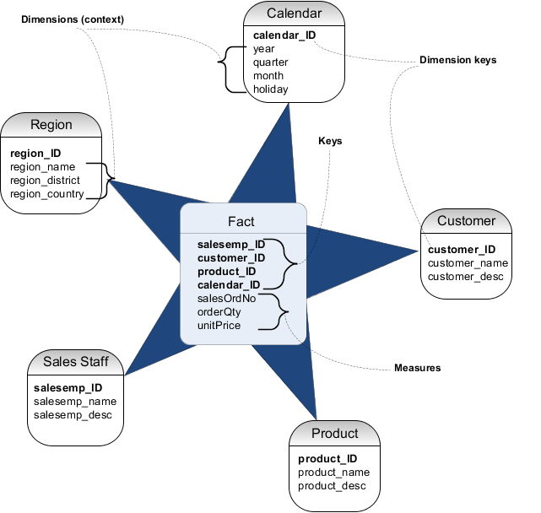
Star Schema
Most simple design and most commonly used
Consists of a fact table that point to dimension tables
Dimensions are not normalized
PKs in dimension tables make up the composite key in fact table
High performance due to simple design and few joins
Recommended for large or small datawarehousing & data marts
Notes:
Normalized meaning they are stored in such a way that they are storage efficient and no compromise on data integrity.

Slide 12
Product
Product _ID
Product_Brand_ID
Product_Type_ID
Product Name
Product Feature Description
……………
Snowflake Schema
Product Type
Product_ID_Type(PK)
Category_1
Category_2
…….
Brand
Brand_ID (PK)
Supplier_ID(PK)
Name
…….
Supplier
Supplier_ID (PK)
Supplier_Name
Address
…….
Snowflake schema is extension to star schema.
Dimension table is extending and normalized into multiple lookup tables
Client
Client _ID
Client_group
Name
Address
Client_Group
Cleint_Group_ID
Group_Name
Group_Category
…….
Month
Month_ID (PK)
Quarter_Id
Month_Name
…………..
Time
Date_ID (PK)
Month_ID
Transaction_Date
…………..
Sale Fact
Product_iD (PK)
Cleint_ID (PK)
Shop_ID (PK)
Date_ID (PK)
Volume
Amount
Quarter
Quarter_ID (PK)
Quarter_NO
Year
…………..
Region
Region_ID
Client_group
Name
Country
Shop
Shop_ID (PK)
City_ID (PK)
Name
Address
City
City_ID (PK)
Region_ID (PK)
Name
--------

Slide 13
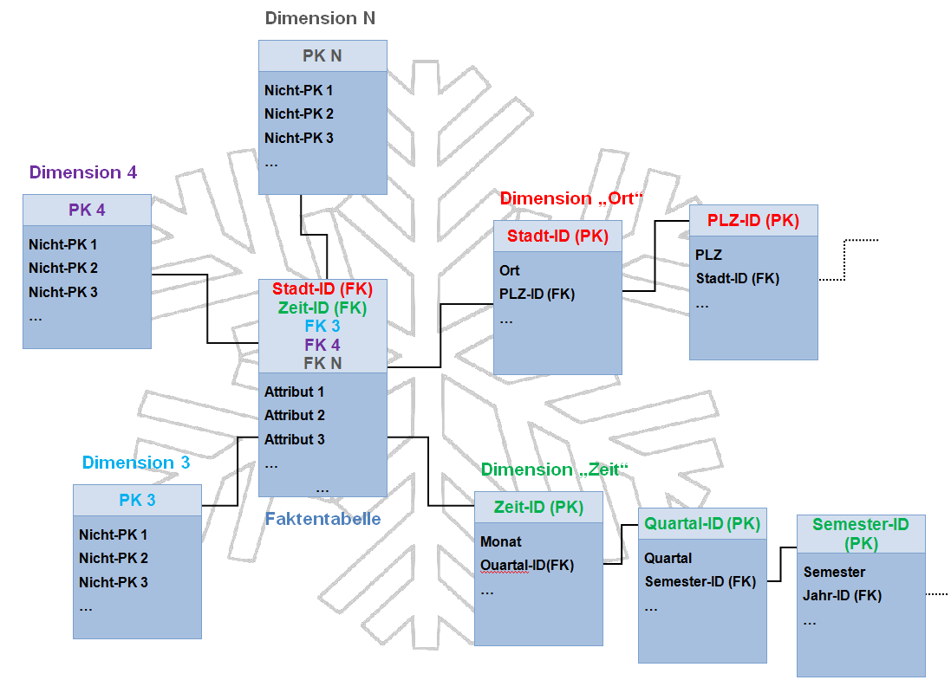
Snowflake Schema
More complex version of Star schema
Dimension tables are normalized
More complex queries due to more joins
Longer query execution times
If dimension tables hold high volume of data snowflake design can save space
Recommended for smaller data warehouses

Slide 14
Some Differences…..

Slide 15
Some Differences
 | Star Schema | Snowflake Schema
Ease of maintenance/Change | Has redundant data and hence less easy to maintain change | No redundancy, so snowflake schemas are easier to maintain and change
Ease of Use | Lower Query complexity and easy to understand | More complex queries and hence less easy to understand
Query Performance | Less number of foreign key and hence shorter query execution time | More foreign key and hence longer query execution time
Type of Data Warehouse | Good for Data Marts with simple relationships(1:1 or !:many) | Good to use for data Warehouse core to simplify complex relationship (Many:Many)
Joins | Fewer Joins | Mostly higher number of Joins
Dimension table | A star schema contains only single dimension table for each dimension. | A snowflake schema may have more than one dimension table for each dimension.
When to use | When dimension table contains less number of rows, we can choose star schema | When dimension table is relatively big in size, snowflaking is better as it reduces space.
Normalization/De-Normalization | Both Dimension and Fact tables in De-Normalized form | Dimension tables are in normalized form but fact table is in De-Normalized form.
Data Model | Top down approach | Bottom up approach.

Slide 16
When to use what?

Slide 17
When to use what?
Star Schema
Snowflake Schema
Simplicity and speed
Ease of understanding
Small to Medium sized data warehousing
Query performance
Data Redundancy not an issue.
Normalization and Reducing Redundancy
Complex Data Relationships
Large-Scale Data Warehouses
Storage Efficiency
Data Update Frequency

Slide 18
Thank you

